Slide 1
White-Rodgers Flame Sensors

Slide 2
Business and Product Overview

Slide 3
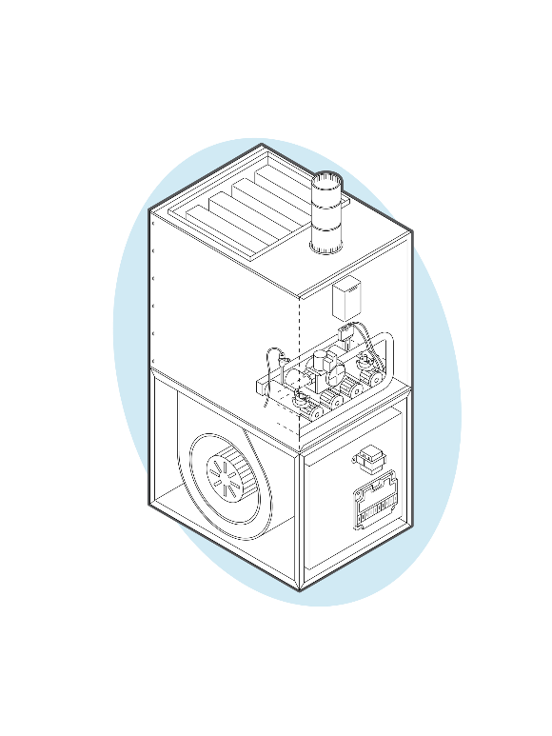
Flame Sensor Basics
Flame Sensors work in the ignition sequence of gas furnaces, ovens, water heaters, boilers and other equipment.
In most applications, an ignitor or pilot is located on one side of the burner rack and the flame sensor is located on the other side. Ignition lights the first burner and the flame carriers over across each burner until it reaches the last burner where the flame sensor is located.
If working properly, the ionized cloud of flame at the flame sensor will carry the flame sensor power to ground creating a DC microamp signal which signals that the burners are lit properly.

Slide 4
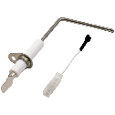
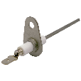
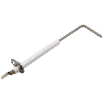
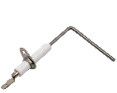
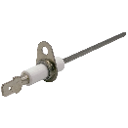
White-Rodgers 790 Series Flame Sensors
790 Series Direct OEM Replacements
Match high volume OEM sensors. For contractors specializing in a particular brand or working in areas where a specific brand is most popular
790 Series Universal Replacement
The universal replacement is designed to work on all the major brands. Replaces direct OEM styles either as a direct drop-in, or by bending to the proper angle and clipping to length
790 Series Universal Replacement
Carrier
Goodman
Lennox
Trane
York

Slide 5
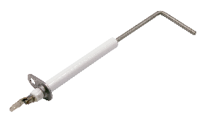
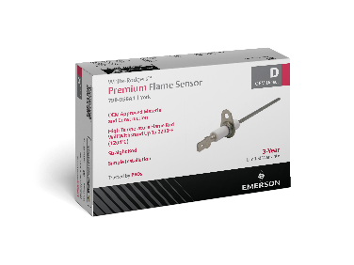
White-Rodgers Flame Sensors - Competitive Advantages
Higher Heat Rating
2200°F heat rating compared to competitors' 1800°F rating
Longer Warranty
3-year warranty compared to other brands 1-year warranty
Direct OEM Replacement or Universal Styles
Allows contractors to choose specific brand or cover all the bases with one model
Display Ready
10 pack Master cartons include hang tabs for individual boxes
790 Series Universal Replacement

Slide 6
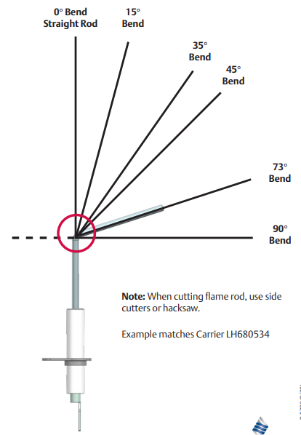
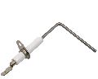
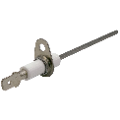
790 Series Replacement Flame Sensors
790 Series Direct OEM Replacements
790 Series Universal Replacement
Replaces
All Points | Groen
Alliance Laundry | Hoyt
American Wtr Heater | ICP
AO Smith | LB White
AP PuraFire | Lennox
Armstrong | Lochinvar
Bakers Pride | Market Forge
Baxter | Mars
Blodgett | Middleby
Carrier | Modine
Goodman | Nieco
Nortek Global | Supco
Packard | Trane
Peerless | Vanguard
Reznor | Vulcan
Rheem | Weil-McLain
Roberts Gordon | Whirlpool
Robertshaw | White-Rodgers
Rupp Industries | York
South Bend | Supco
Sterling | Trane
Stero
790-843A1
Carrier Style 790-751A1
Goodman Style
790-707A1
Lennox Style
790-801A1
Trane Style
790-820A1
Note: When cutting flame rod use side cutters or hacksaw.
Example matches Carrier LH680534
York Style 790-956A1

Slide 7
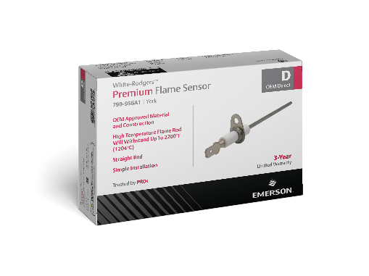


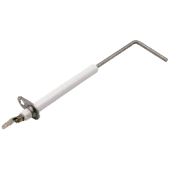


790 Series Direct OEM Replacements
Direct drop-in replacements
High temperature rod withstands 2200°F
OEM approved construction and material
3 Year limited warranty
CARRIER / ICP 790-751A1 / 73° BEND | GOODMAN 790-707A1 / STRAIGHT ROD
LENNOX 790-801A1 / 90° BEND | TRANE 790-820A1 / 90° BEND | YORK 790-956A1 / STRAIGHT ROD

Slide 8

790 Series Universal Flame Sensor
Direct drop-in for most sensors. Rod can be bent and trimmed to replace over 150 part numbers including all direct OEM replacement models
High temperature rod withstands 2200ºF
Protective sleeve included for bending the rod with detailed instructions and angle guide
3 year limited warranty
30" lead wire with 1/4" and 3/16" quick connects
790-843A1
Note: When cutting flame rod use side cutters or hacksaw.
Example matches Carrier LH680534
Available as a 5 pack
790-843A5PK

Slide 9
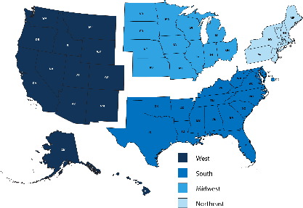
Market Data
Our projections put the total replacement market in the United States at ~58 Million forced hot air gas furnaces.
  West 13.9 Million
  Midwest 18.7 Million
  Northeast 11.3 Million
  South 13.9 Million
Single Stage Homes Total: 57,800,000
13,900000
18,700,000
11,300,000
13,900,000
*WR Estimate

Slide 10

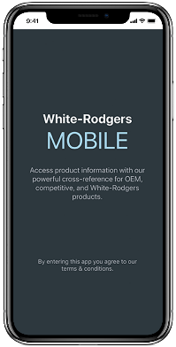



WR Mobile App
Always up-to-date and easy to use:
Mobile App
White-Rodgers Website
Your resource for:
Product information and spec sheets
Complete Cross Reference
OEM compatibility
Installation information and videos
Wiring diagrams
Download:
Go to your app store
Type in WR Mobile
Install the app
OR
Open your camera
Hold it over the QR code
Tap “Open” on the
pop-down
Install the app

Slide 11
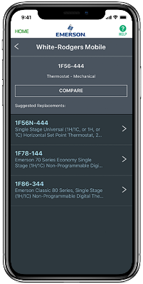
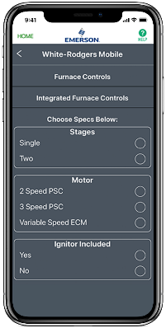
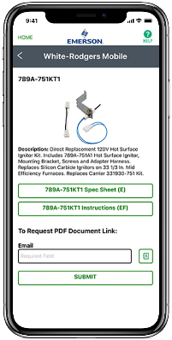
WR Mobile App
Easy to use!
Search by OEM, Competitive, or White-Rodgers Model Number
Product Number
Scrollable Product List
WR Replacement

Slide 12

White-Rodgers Cross Reference
Go to: www.whiterodgers.com
Hover over Tools & Resources
Click on: White-Rodgers Cross Reference/Product Information
Enter the Model Number or click on: Search Replacement Heating Controls by Major OEM Brand

Slide 13
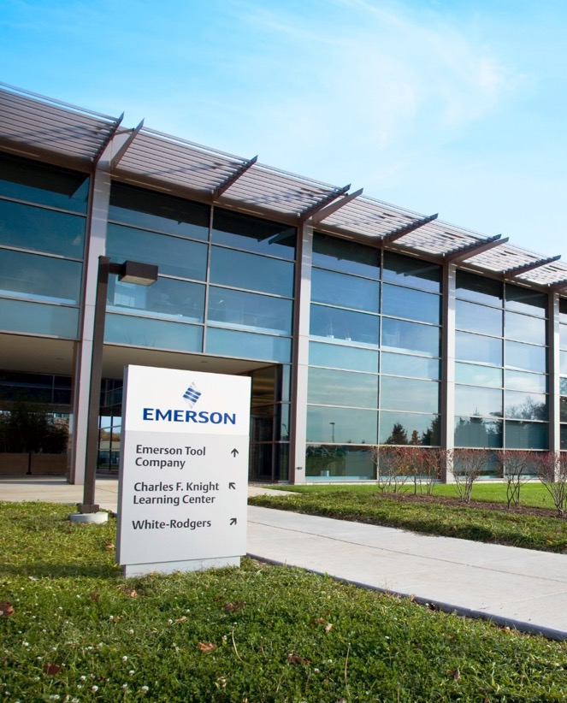
Why Contractors Trust White-Rodgers
Industry Leading Products
Used by more OEM’s
Offering the widest range of Universal Replacement Controls
Ease of Installation
Simple, easy to understand instructions
Product Reliability
Quality Control assures reliable products
Affordable
Competitive pricing
Supported by Knowledgeable Representatives
Contractor direct phone support

Slide 14
Technical
White-Rodgers 790 Series Flame Sensors

Slide 15
White-Rodgers Flame Sensors - Competitive Advantages
Higher Heat Rating
2200°F heat rating compared to competitors' 1800°F rating
Longer Warranty
3-year warranty compared to other brands 1-year warranty
Direct OEM Replacement or Universal Styles
Allows contractors to choose specific brand or cover all the bases with one model
Display Ready
10 pack Master cartons include hang tabs for individual boxes
790 Series Universal Replacement

Slide 16
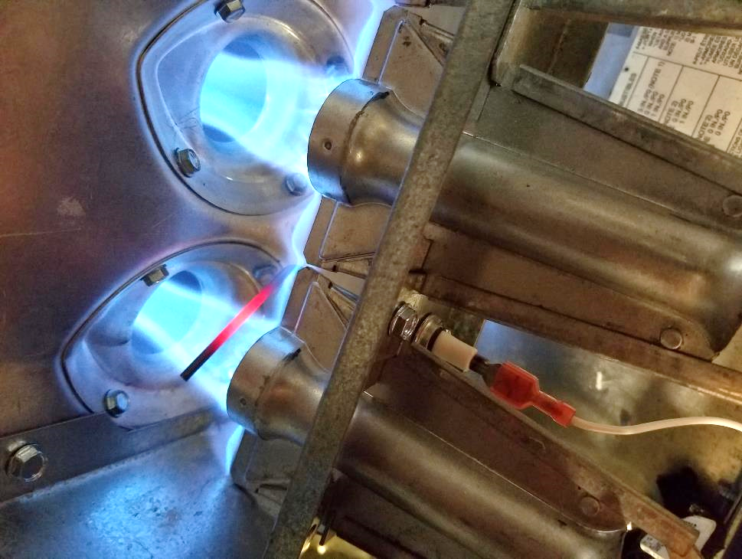
Purpose of Flame Sensing
To verify ignition and avoid catastrophe
  Gas-fueled appliances efficiently supply heat
  Automatic controls effectively supply fuel to burners and provide a source of ignition
  Without an effective means to monitor the presence of a flame, fuel could be introduced into the living space
  If an uncontrolled fuel source finds a means of ignition, the results can be tragic
  A flame monitoring device is designed to terminate the flow of fuel if an ignition failure occurs
Flame rod proving the presence of a flame

Slide 17
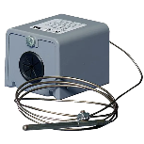
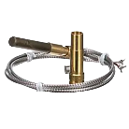
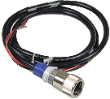
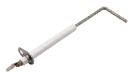
Types of Flame Monitoring in Gas Appliances
Infrared (IR) Ultraviolet (UV) | Electromechanical | Thermocouple | Thermopile | Flame Rectification
Optical sensor detects wavelengths of light emitted by the flame | Heat from flame increases pressure in sensing bulb and activates a switch | Dissimilar metals exposed to heat generate a small amount of voltage | Thermocouples wired in series generate higher voltage | Uses the electrical conductivity of the flame to prove the presence of the flame
:

Slide 18
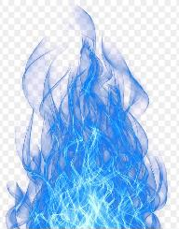
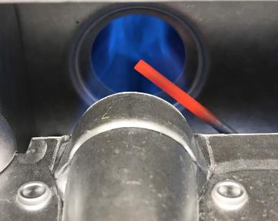
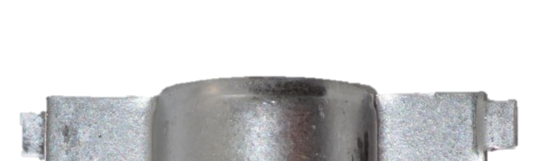
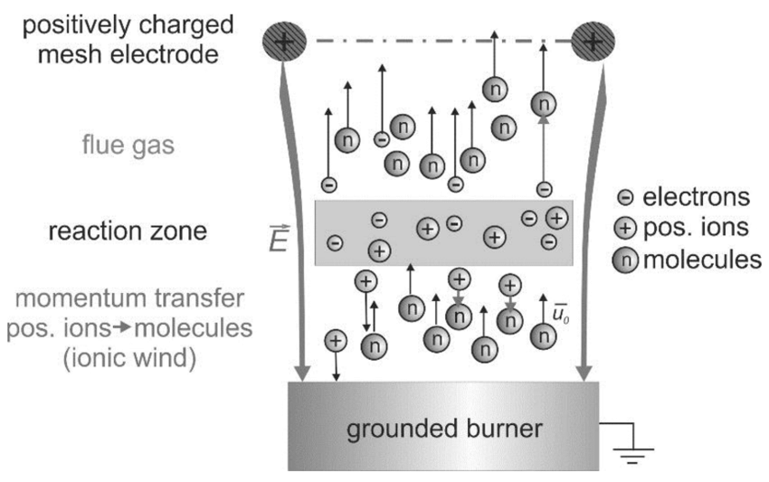
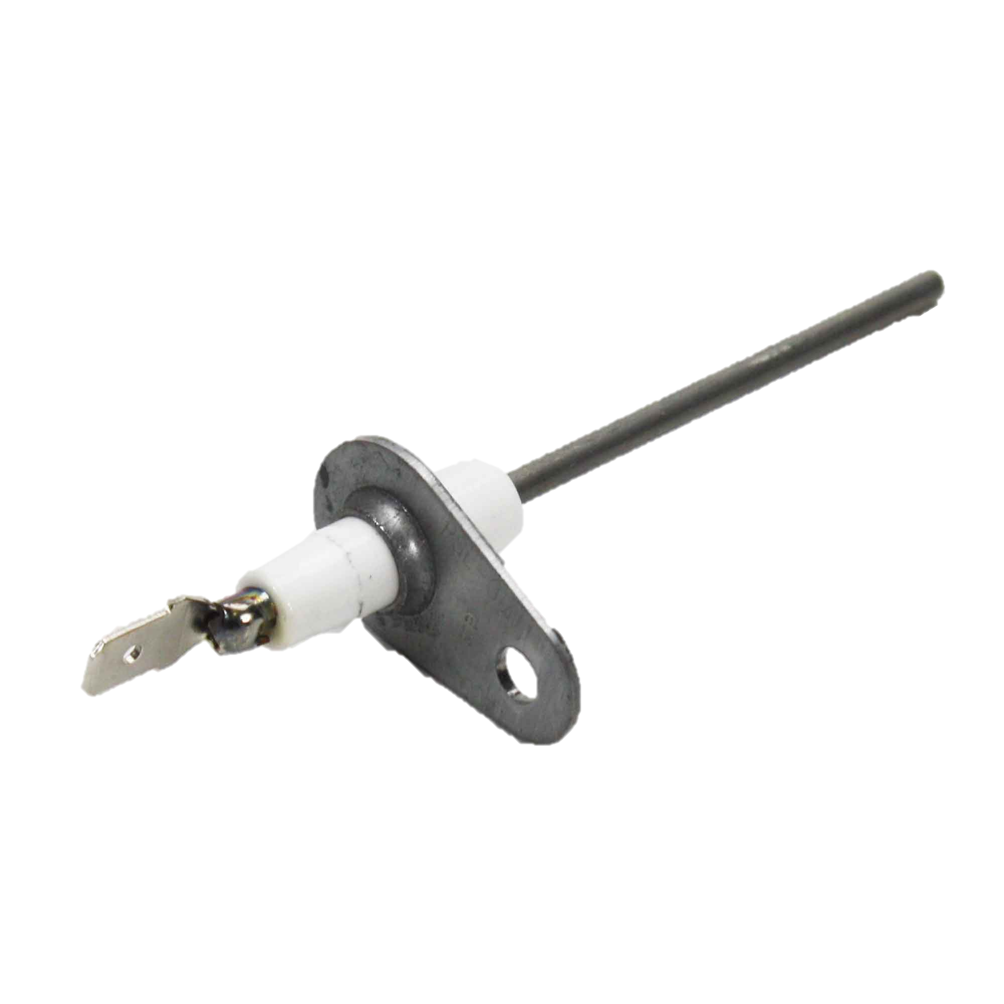

Flame Sense Basics
During the Combustion Process:
Carbon, Hydrogen, & Oxygen atoms are separated.
Flame Ionization creates free positive ions within the flame.
Positive ions carry the flame probe voltage to the grounded burner completing an electrical circuit
Positive ions only carry ½ of the AC signal to ground creating a rectified DC circuit
The DC voltage grounding to the burner metal through the positive ions is so small it can only be read in microamps.
+ Voltage
- Ground

Slide 19
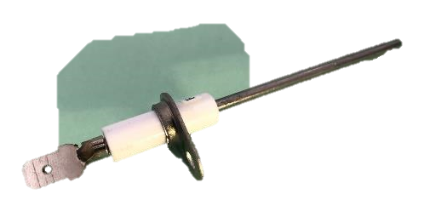
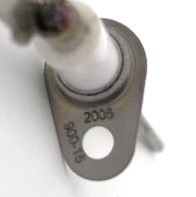
White-Rodgers Flame Sensor Materials
Nickel Plated Steel Terminal Spade connector terminal is corrosion resistant for reliable flame sense connection
Kanthal Rod (Iron, chromium and aluminum) features high heat resistance, excellent conductive properties and corrosion resistance
Alumina Ceramic Insulator Is extremely resistant to wear and an excellent insulating material
2
1
3

Slide 20
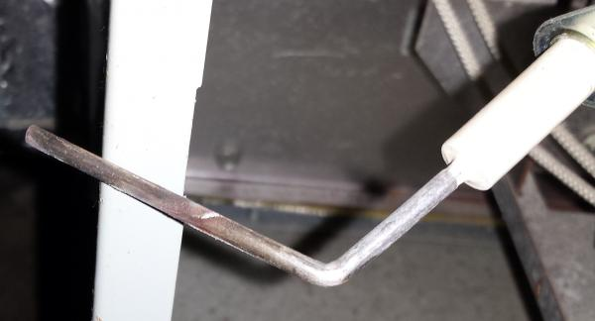
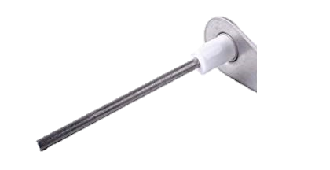
Flame Sensor Failure
Flame Sense Failure Can Be Caused By:
Improper or failed flame carry over between one or more burners
Carbon deposits, scale, rust or contamination on the flame sensor rod
Bent, misaligned or incorrect rod positioning
Grounded flame sensor lead, cracked sensor insulator, or poorly grounded module or furnace
A low flame sense signal will cause the control module to turn off the gas, purge the combustion chamber, and retry or lock out entirely.

Slide 21
Flame Rod Maintenance
Surface Degradation
Film Build-Up
Cleaning the rod with a coarse material such as sandpaper can potentially roughen it to the point silicon oxide will build up faster.
During the combustion process, silicon oxide is formed as a small by-product of the burnt fuel that appears as a white coating. This can prevent the voltage from being able to ground properly.

Slide 22
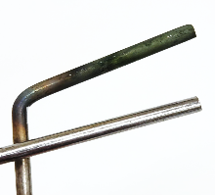
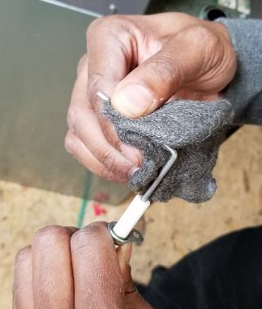

Annual Maintenance on a Flame Sensor
The flame sensor should be cleaned annually
  Remove flame sensor from burner compartment
  Use a fine abrasive steel wool or scouring pad to clean of the carbon buildup
  Replace flame sensor
Carbon buildup
Clean and polished
TECH TIP: Don’t clean a flame rod by scraping it or using a coarse abrasive like sandpaper.

Slide 23
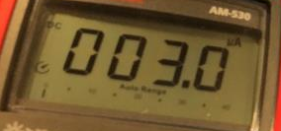
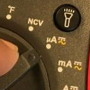
Flame Sensor Testing Tips
Ignition Modules Have a Minimum Flame Sense Current Required to Insure Flame Detection (Generally .25 – 2.0 Μa DC)
Test flame sense with a flame present and meter in series with the flame probe/ on test pins
Most modules flash a code when flame sense is low
When flame sense is low, the gas turns off, the module purges the combustion chamber and retries or locks out entirely
To Improve the Flame Sense Reading:
Wire connection should be tight and solid, lead insulation should not be cracked, melted or damaged
  Verify flame sensor porcelain is not cracked
Mounting bracket should be clean and tight
Flame rod should be clean and smooth
  Use fine emery cloth or steel wool to polish rod portion to a clean smooth finish

Slide 24
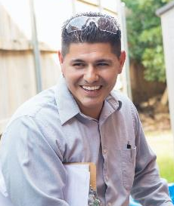
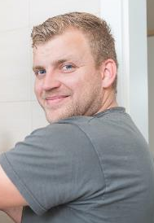
White-Rodgers Flame Sensor Testimonials
March 15, 2017– jcspress
  “This piece did the trick, and we had heat instantly that night. Perfect product and seller”
January 7, 2022 - oddi996
  “Good quality at a good price”
January 8, 2020 - Realist
  “These ignitors are fantastic! We have multiple rentals and having these on hand has saved us a lot of money. The included universal brackets go a long way in adapting this ignitor to any of our furnaces.

Slide 25
Installation
White-Rodgers 790 Series Flame Sensors

Slide 26
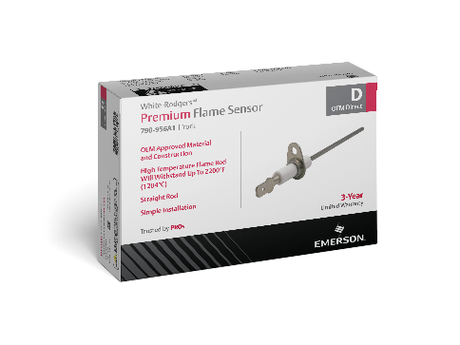
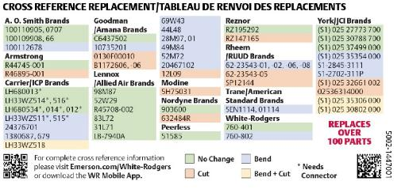
What’s in the Box? (Universal)
Contents:
Flame Sensor
Installation Parts
Instruction Sheet
Bending Guide
Cross Reference
Cross Reference on the Box
Note: When cutting flame rod use side cutters or hacksaw.
Example matches Carrier LH680534

Slide 27
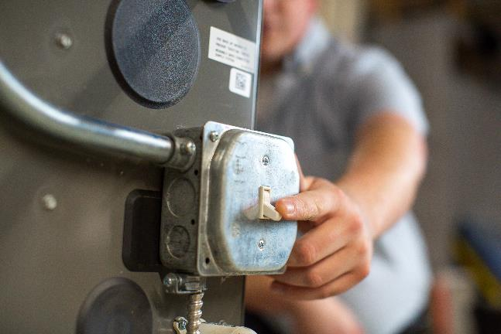
Flame Sensor Installation
1
Turn off electric/gas to the appliance until installation is complete.

Slide 28
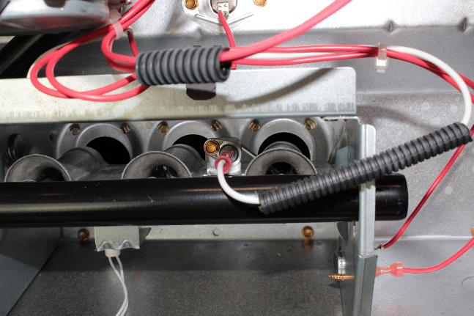
Flame Sensor Installation
2
Note location of flame sensor lead and position of flame sensor rod to burner.

Slide 29
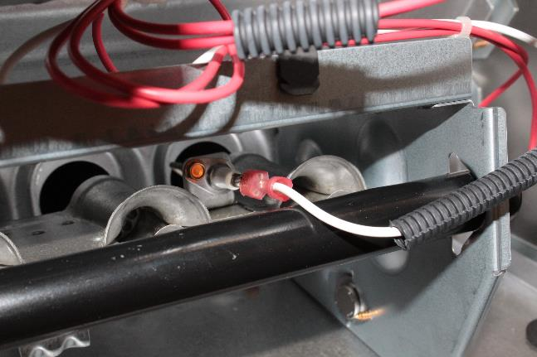
Flame Sensor Installation
3
Verify replacement sensor matches original equipment connection, rod angle and rod length.

Slide 30
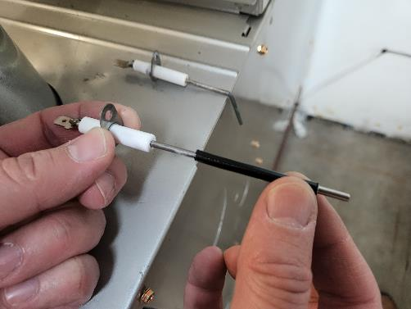
Rod Adjustments
3A
Slide the protective sleeve over the Universal Flame Sensor rod.

Slide 31
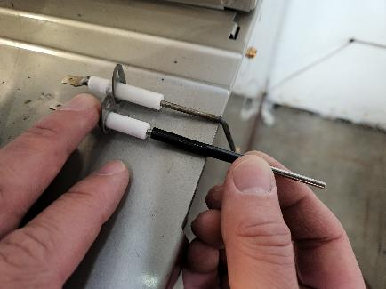
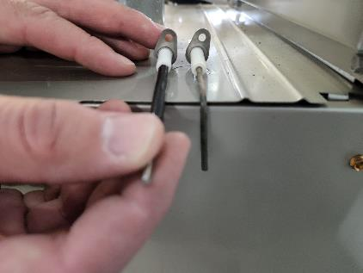
Rod Adjustments
3B
Align the Universal Flame Sensor with the original, keeping the distance from the mounting bracket to the bend point and the angle of the mounting bracket the same.

Slide 32
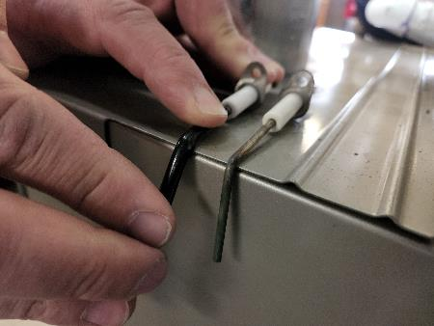
Rod Adjustments
3C
With the protective sleeve in place, use the corner edge of a hard surface to make a sharp bend in the Universal Flame Sensor. Stop when it matches the bend angle on the original.
TECH TIP: The steel rod is very stiff and requires a lot of force to bend it.

Slide 33
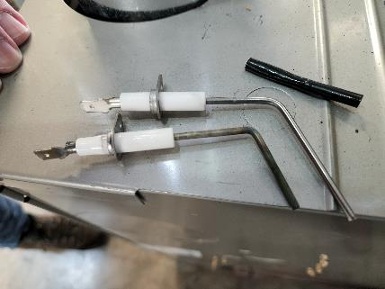
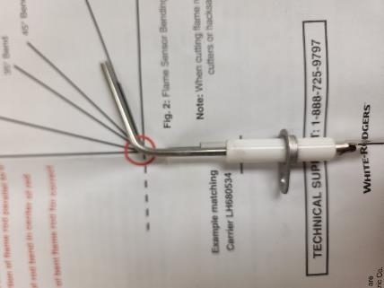
Rod Adjustments
3D
Compare the bend to the original or the bending guide in the instruction manual.

Slide 34


Rod Adjustments
3E
Trim the Universal Flame Sensor with side cutters to match the length of the original.

Slide 35

Flame Sensor Installation
4
Remove existing assembly (it’s only one screw).​

Slide 36

Flame Sensor Installation
5
Connect flame sensor and insert in the original location, screw firmly to appliance and verify sensor avoids high temp areas.​

Slide 37
Flame Sensor Installation
6
Turn on power and gas, check for proper operation.​

Slide 38


Universal Flame Sensor Bending
A bend angle guide is included in the installation instructions to match an angle or multi-angle OEM sensor.
Following the bending guide, orient mounting hole in flange to rod angle direction matching the OEM sensor
Place protective sleeve over the rod and place the sensor bend line on the edge of a hard surface
Secure the ceramic end parallel to the hard surface
Apply downward pressure on the rod tip until bend angle is achieved
0° Bend – straight rod
15° Bend
45° Bend
73° Bend
90° Bend
Fig. 2: Flame Sensor Bending Angle Guide

Slide 39
Flame Sensor Troubleshooting
The ignition module determines the minimum flame sense current required to insure flame detection.
Consult the installation instructions for minimum flame sense current for an ignition control. The specs will normally have at least two values:
    Minimum current to ensure flame detection
    Maximum current for non-detection
A control seeing marginal or low flame sense may still function between the two listed values, but will require service.
As an early warning, most ignition modules provide a low flame sense flash code.
If the current goes below the low flame sense flash code trigger, or reaches 0 microamps, the control will flash the Retry Exceeded - External Lockout code.
The control will then turn off the gas, continue running the inducer to vent the combustion chamber, and either retry or lockout
R-5461-3

